Slide 1
Freshman RPG
Iteration #1
Vanity Items

Slide 2
Old Functionality
Players had a predetermined outfit.
The only time their outfit changed is when they got sorted by the Sorting Hat

Slide 3
Our Goal
To allow customization of parts of the character rather than changing the whole character.

Slide 4
What We Can Do in the Future
Allow people to change clothing.
Add a shop to allow people to buy clothing.
Add more types of clothing like shirt, pants, hair, eyes, and shoes.
Add a way for players to keep track of the clothing they own.

Slide 5
Bugs
Character and NPC stay on screen when changing maps.
Character walking/running animation does not stop.

Slide 6
Let’s See It in the Game!

Slide 7
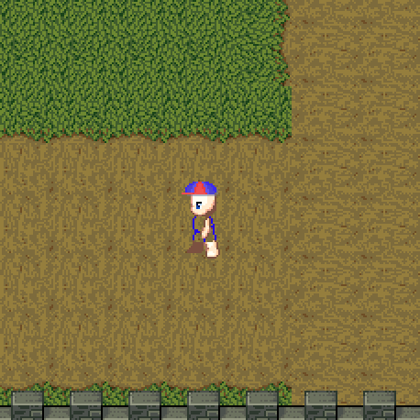
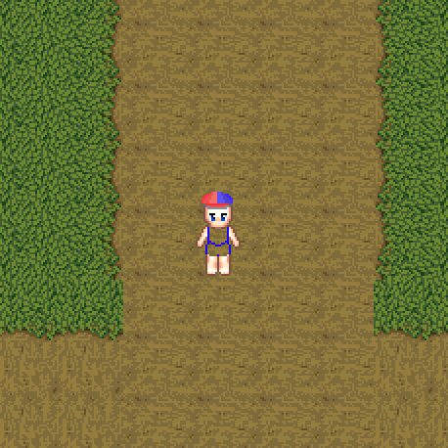
Ship Hat and a Blank Body

Slide 8
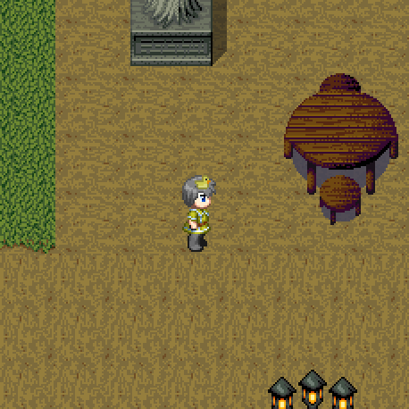
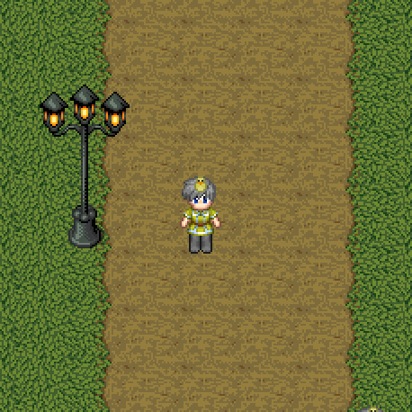
Duck Hat and Some Clothing

Slide 9
Any Questions?

